Slide 1
We create a better tomorrow through technology

Slide 2
Everyone is going through digital transformation. Many needing a bit of help to do it. This is where we come in – hand in hand with the latest and greatest technology.

Slide 3
Who is twoday?
twoday is a full service technology company, focusing on software development, data & business intelligence, AI & automation, consultancy services and tailor made applications to both the private and public sector. With our 2700 top professionals across the Nordics and Lithuania and a revenue of 356mill Euro in 2023, we are a leading partner in helping our customers succeed in their digital transformation.
twoday we create a better tomorrow through technology.

Slide 4
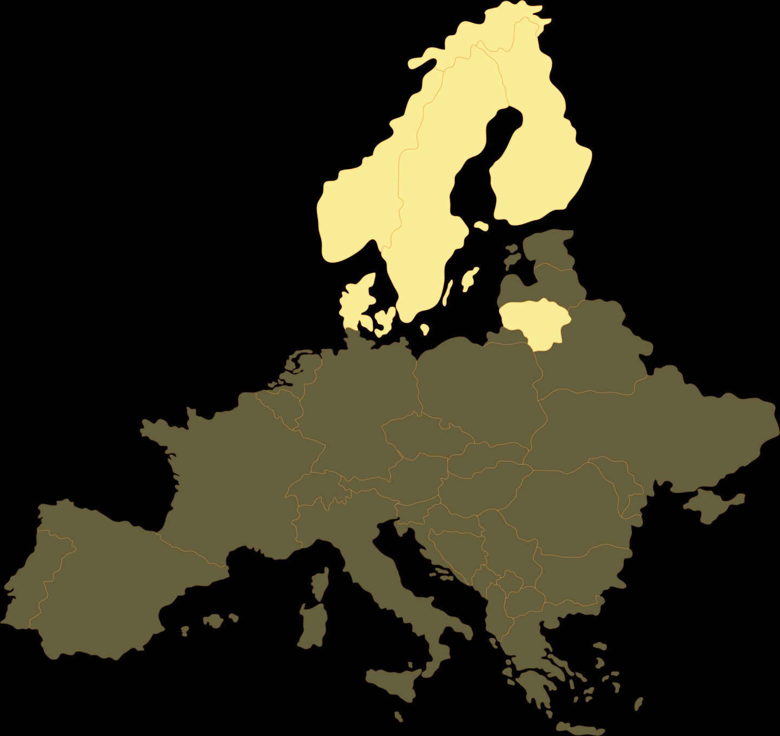
Pan-Nordic footprint
2,700
Employees
34
Finland
Locations
Norway
Norway Denmark Sweden Finland Lithuania
500 employees 1000 employees 300 employees 700 employees 150 employees
Sweden
€356
Millions in revenue 2023
Denmarkv
Lithuania

Slide 5
Why is our name twoday?
The “two” in twoday represents partnerships with customers and togetherness among employees. Two also represents equality, teamwork and cooperation between people.
“twoday” represent drive, presence, availability and trust in delivering on time.
twoday - we create a better tomorrow through technology

Slide 6
twodays values
Heart
Drive
Adaptability
Our business is run with heart. We care about people, our customers and society. We are a warm community filled with people that have fun and laugh together. We welcome people as they are, we team up and thrive together.
To succeed in the digital transformation of our society we need people with initiative, dedication and engagement. People that continuously develop themselves and learn new things is the key to deliver the competence that is needed in the digital age. Our drive and ambition moves society forward.
Technology is constantly changing and so are the needs of people and organizations. We are adaptable in our approach, down to earth and easy to work with. We trust in people and believe that we do our best with a good balance of freedom and responsibility.

Slide 7
Our services

Slide 8
Digital solutions that make an impact
Data & AI
Software Engineering
Digital experiences
Business applications

Slide 9
Data & AI
At twoday we specialize in harnessing the power of data and artificial intelligence (AI) to drive businesses forward. Our data and AI services are designed to empower organizations by delivering solutions that enhance decision-making and fuel business outcomes.
Data strategy
BI & analytics
Data platforms
Corporate performance management
Process development & automation
AI
IoT

Slide 10
Software Engineering
At twoday we drive digital transformation through custom software development, leveraging cloud services and application expertise. We utilize the latest technology, to develop high-quality and scalable software solutions following industry best practices.
Digital transformation
Software development
Cloud services
Application services
Consulting
Security

Slide 11
Digital experiences
At twoday we turn ideas into top-notch digital experiences. Whether it's refining company brands, designing user-friendly websites, setting up seamless eCommerce solutions, or crafting modern workspaces, we've got you covered.
Branding
Design & UX
Websites
eCommerce & PIM
Intranets
Apps
Digital marketing

Slide 12
Business Applications
At twoday we elevate business operations through business applications that not only reduce costs but also increase efficiency. With our solutions for ERP, sales & marketing, customer service, and more, we're dedicated to your success.
Sales & marketing
Customer service
Low code
ERP
Digital signature & authentication
Integration platform
Modern work

Slide 13
Best-in-class track-record of delivering profitable growth
356
322
294
CAGR 2015-2023
Revenue: 23%
Cash EBITDA: 26%
235
207
170
124
92
70
47
49
51
29
39
40
15
21
8
2015
2016
2017
2018
2019
2020
2021
2022
2023
Revenue (EUR)
Cash EBITDA (EUR)

Slide 14
Public sector
Labour, welfare & health
Education
Taxation & Finance
Justice & immigration
Local government
Technical adm. infrastructure

Slide 15
Private sector
Finance
Retail
Energy
Manufacturing
Other

Slide 16
Strong and competent new owner
CVC is one of the largest private equity and investment firms in the world
Experienced team with Nordic presence
Believes in our strategy and will support our future growth both organically and through acquisitions

Slide 17
Attractive employee incentive program
Unique and attractive employee incentive program
Give all our employees the opportunity to invest and take ownership in the new company
Invest on the same level as our new owners in CVC
Opportunity to personally take part in the growth going forward

