Slide 1
We create a better tomorrow through technology

Slide 2
Megatrends are transforming our market and shaping demands
The rise of AI
Green transition
Ageing population
Digital-first world
Geopolitical shifts
72% of business leaders see AI as central to their business by 2025
New regulations are driving companies to use digital engineering for environmental compliance
By 2050, 1 in 6 people will be aged 65+, challenging governments to rethink healthcare, social care, and public services
Consumers expect seamless digital experiences, with 79% of organizations citing cybersecurity as a top priority
Global power dynamics are changing, requiring Europe to invest in defense and security, driven by AI and data technologies

Slide 3
Who is twoday?
twoday is a technology company, focusing on software development, data & business intelligence, AI & automation, consultancy services and tailor made applications to both the private and public sector. With our 3000 top professionals across the Nordics and Lithuania and a revenue of 356mill Euro in 2023, we are a leading partner in helping our customers succeed in their digital transformation.
twoday we create a better tomorrow through technology.

Slide 4
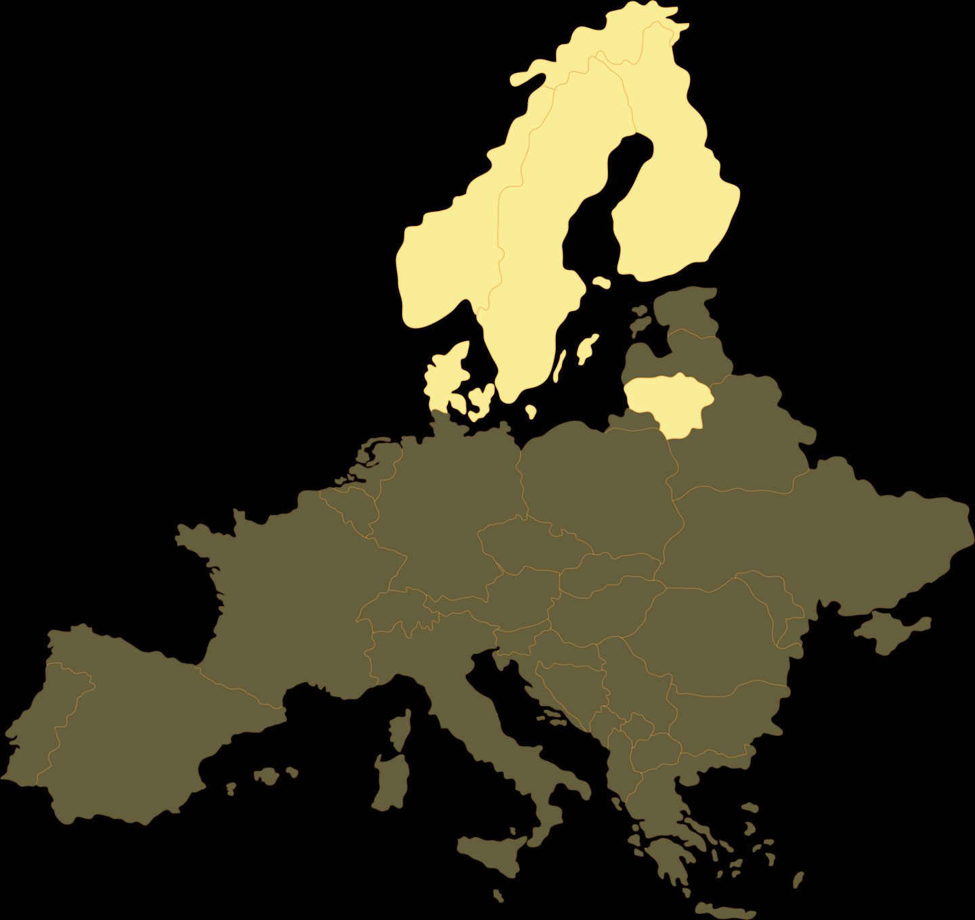
Always close to you
34
Locations
3,000
Finland
Norway
Employees
Sweden
Denmark
Lithuania

Slide 5
Attractive employee incentive program
Unique and attractive employee incentive program
Give all our employees the opportunity to invest and take ownership in the new company
Invest on the same level as our new owners in CVC
Opportunity to personally take part in the growth going forward

Slide 6
Stronger together - our core values guide us to create better solutions for you
Heart
Drive
Adaptability
Our business is run with heart. We care about people, our customers and society. We are a warm community filled with people that have fun and laugh together. We welcome people as they are, we team up and thrive together.
To succeed in the digital transformation of our society we need people with initiative, dedication and engagement. People that continuously develop themselves and learn new things is the key to deliver the competence that is needed in the digital age. Our drive and ambition moves society forward.
Technology is constantly changing and so are the needs of people and organizations. We are adaptable in our approach, down to earth and easy to work with. We trust in people and believe that we do our best with a good balance of freedom and responsibility.

Slide 7
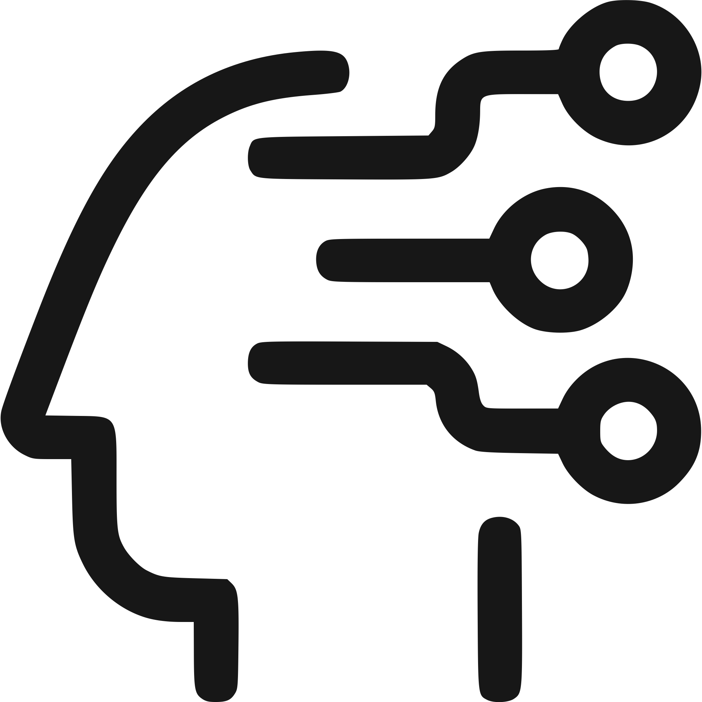
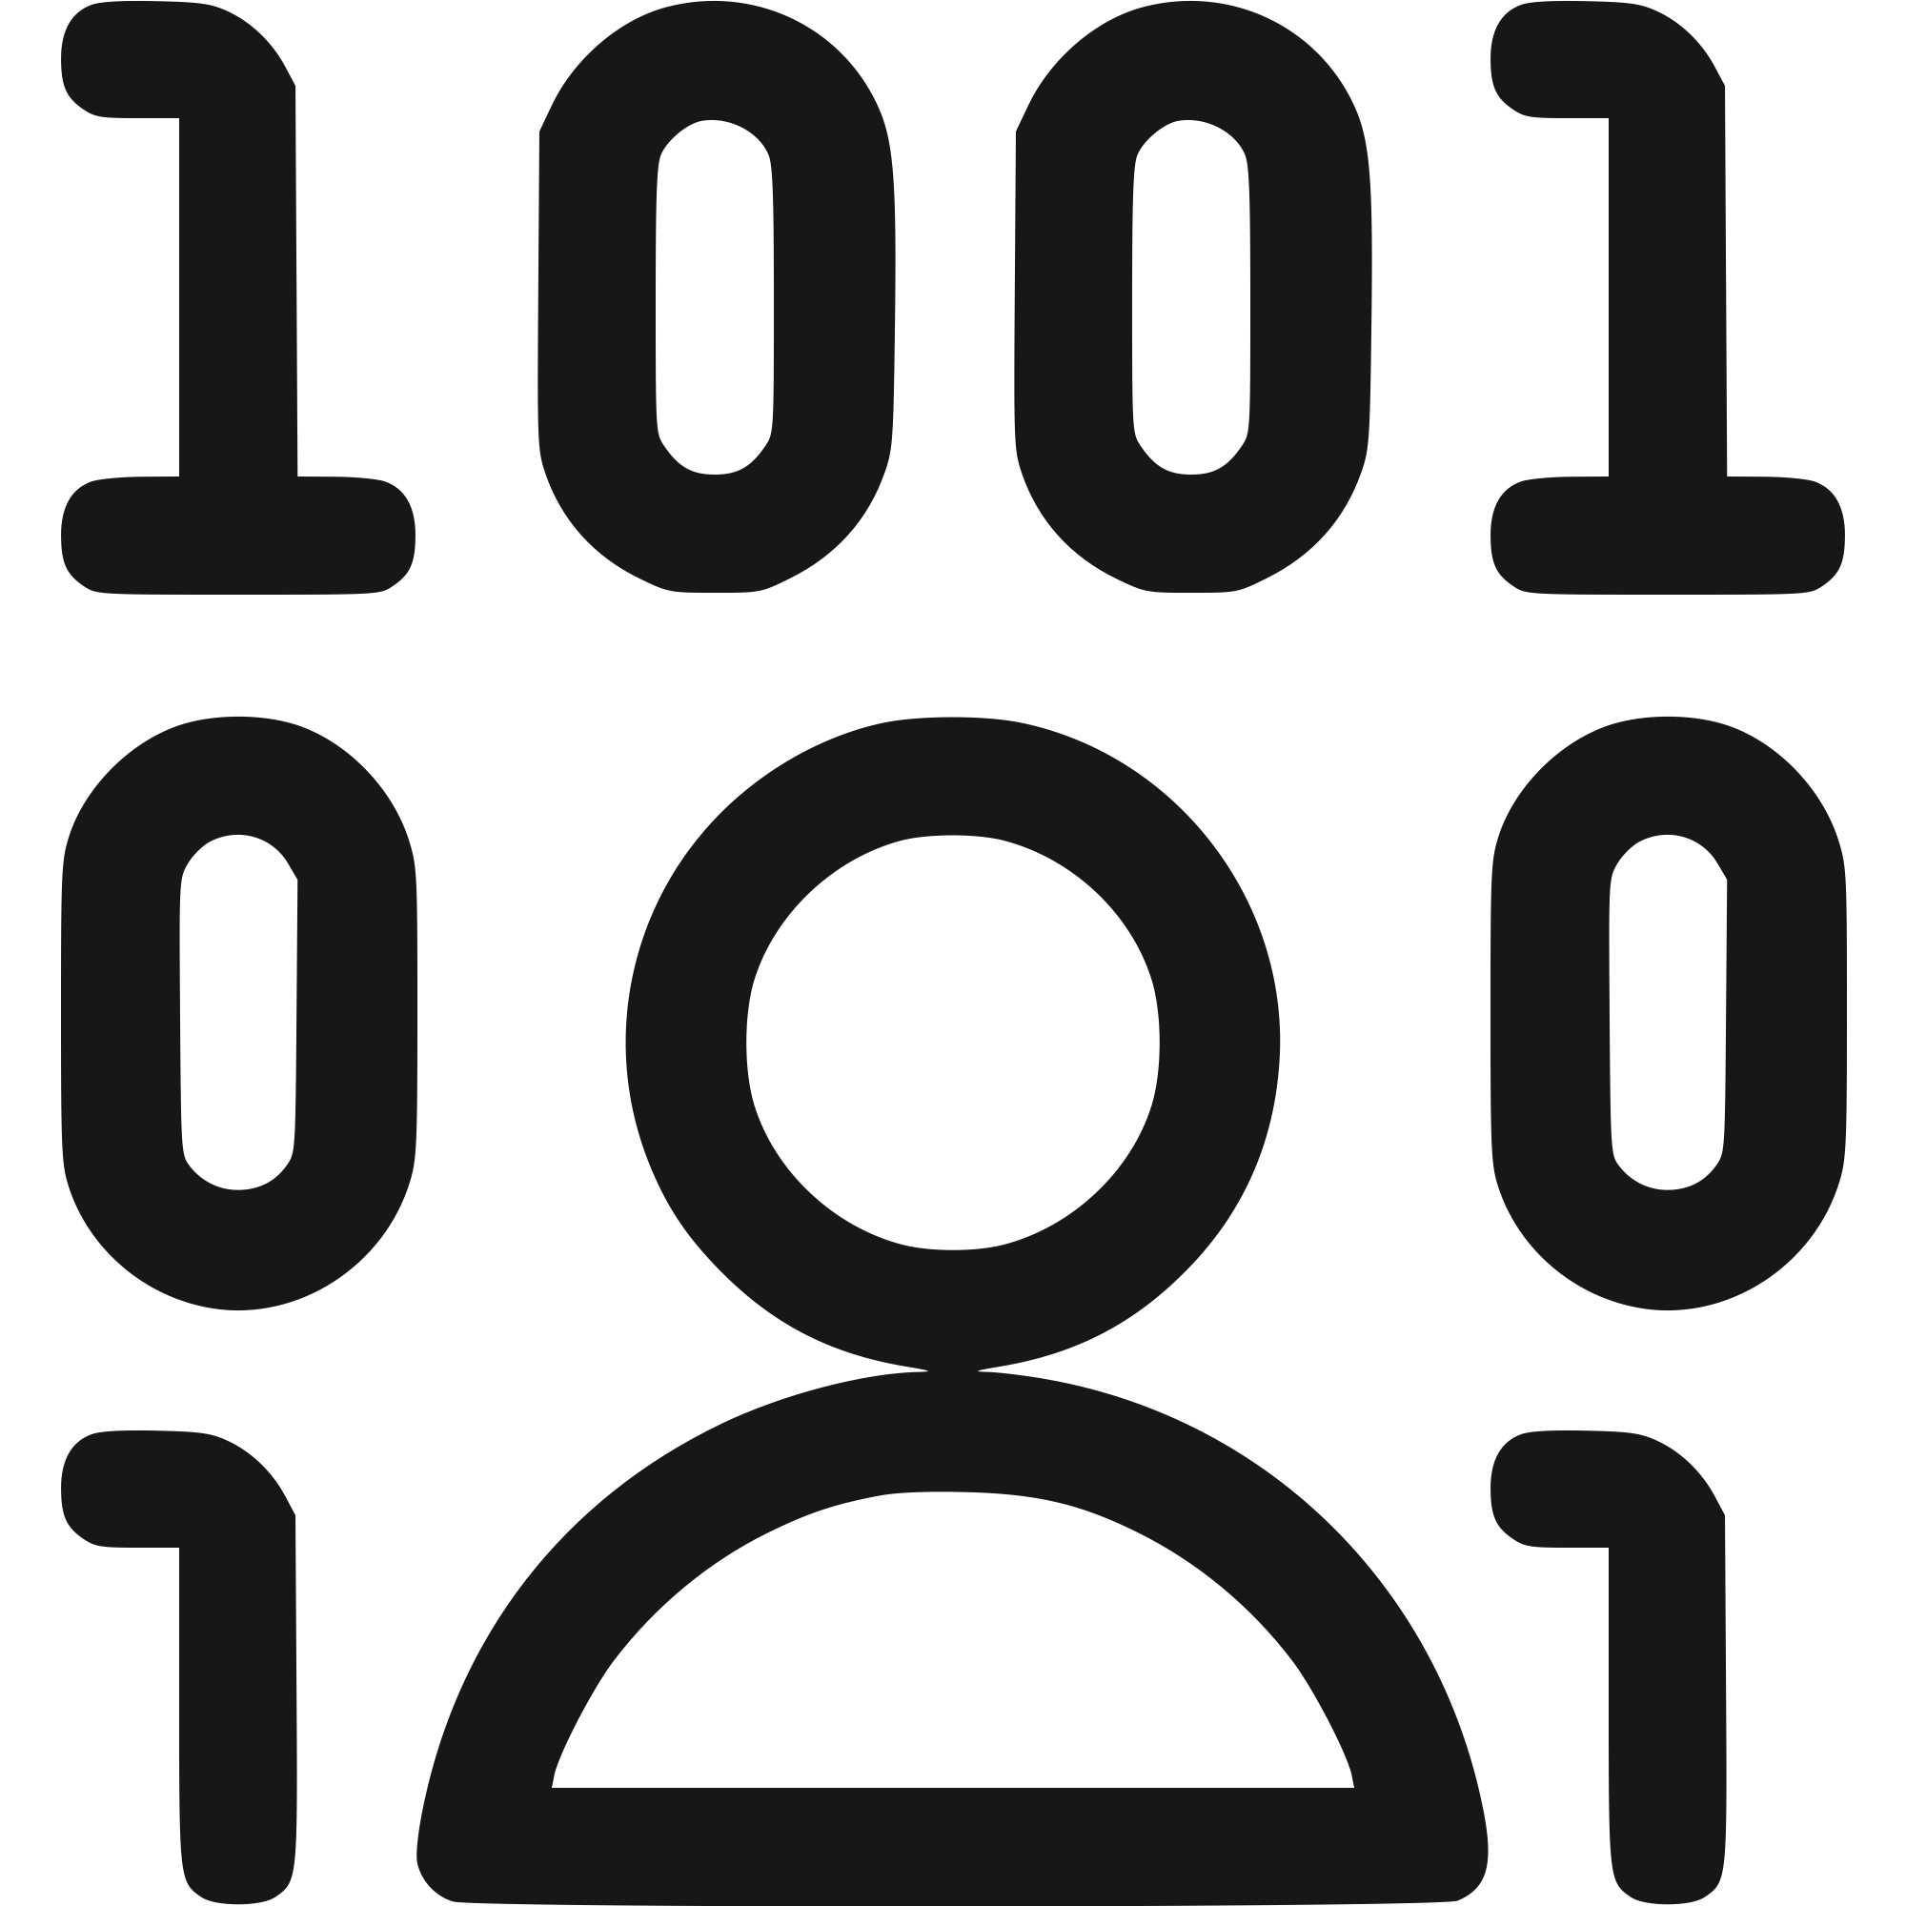
Transforming tomorrow through Data & AI
At twoday we specialize in harnessing the power of data and artificial intelligence (AI) to drive businesses forward. Our data and AI services are designed to empower organizations with solutions that enhance decision-making and fuel business outcomes.
AI Strategy
Our AI Program supports all phases from ideation, use case assessment to user adoption and IT operations.
Custom AI
When it is necessary to move beyond off-the-shelf AI solutions, our expert AI consultants deliver Tailored AI Solutions to your business needs.
Embedded AI
Our ability to deliver Embedded AI Solutions makes it possible to integrate AI capabilities directly into hardware devices or software.
Productized AI
We have a proven track record of use case implementations with ready to deploy Productized AI Solutions which are cost-effective and easy to integrate.
300+ AI Use Cases in production​
for 200+ Customers in private & public sectors
by 110+ AI experts working on various advanced use cases in large Nordic companies​​

Slide 8
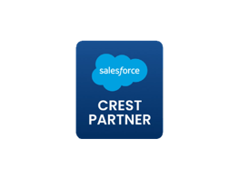
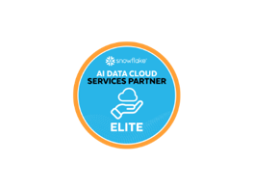
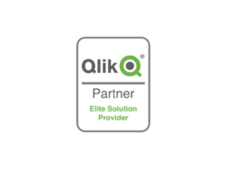
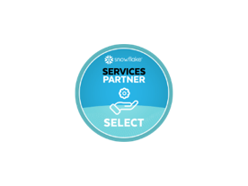
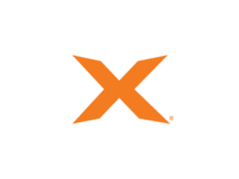
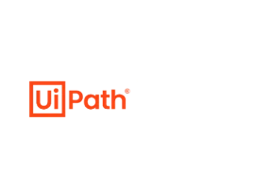
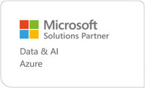
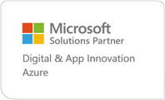
Partnerships & Certificates
At twoday, our partnerships and certifications reflect our dedication to quality and expertise. By working with industry leaders and maintaining trusted credentials, we ensure our solutions are reliable, secure, and built to meet your unique challenges.
Other
With experts all around the Nordics, we make sure you reach your goals.
Microsoft
Partnering with us means partnering with one of the leading Microsoft Solutions Partners.
Salesforce Partner Crest Status
Snowflake AI Data Cloud Services Elite Partner
LS Retail - Diamond Partner
Qlik - Elite Solution provider
Snowflake Elite Partner
Databricks
TimeXtender Heart Partner
UiPath Authorized Business Partner
Pigment Consulting Regional Partner
Anaplan Delivery Partner – Finance

Slide 9
Industries

Slide 10
Industries and services overview
Energy
& Utilities
Industrials & Manufacturing
Health
& Life Sciences
Government
Data & AI
Software Engineering
Cloud Platform & Security
Digital Experience
Business Applications
Digital strategy
Industry domains
Service areas

Slide 11
Solving industry challenges with technology
Energy & Utilities
Industrials & Manufacturing
Health & Life Sciences
Government

Slide 12
Energy & Utilities
Industries
The energy and utility sector is at a pivotal stage with the transition to renewable energy, increasing electricity consumption, and growing consumer expectations.
This calls for innovative and secure energy and utilities software solutions and with our in-depth industrial expertise, twoday can help you become a market leader.
Accelerate the energy transition
Tailored digital solutions for Energy & Utilities
Industry expertise
Drive data-driven decisions
Improve sustainability reporting
Scalable and secure solutions

Slide 13
Industrials & Manufacturing
Industries
Industrial companies are experiencing big needs for business transformation due to globalization and tougher competition. New technology, including industrial manufacturing software, is providing great opportunities to tackle these challenges on many fronts.
We are ready to help you on the journey towards future success.
Prevent downtime with real-time production monitoring
Enhance efficiency with smart system integration
Optimize operations with AI & IoT
Leverage scalable and secure IT solutions
Protect your production with cybersecurity for IT & OT
Stay compliant with automated documentation and traceability

Slide 14
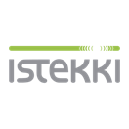
Health & Life Sciences
Industries
The healthcare sector is undergoing extensive digitalization. Robots, AI-based diagnoses, and digital consultations are gaining ground everywhere.
twoday is a key supplier of custom healthcare software solutions to the healthcare sector and has extensive experience in delivering comprehensive and secure healthcare software solutions for citizens and professionals in both public and private healthcare.
Utilization of data and AI
Telemedicine
Health apps
Expertise within health & life sciences
Scalable and secure solutions
Tailored digital solutions

Slide 15
Government
Industries
Helping public organizations modernize their IT
Governments are under pressure to provide efficient, secure, and accessible digital services while meeting regulatory demands and budget constraints. For years, twoday has been a trusted IT partner for the Nordic public sector, helping organizations streamline operations, improve citizen services, and strengthen security with modern, scalable solutions.
We support public organizations by:
Improving citizen services with intuitive, user-friendly digital platforms.
Increasing efficiency through automation and better data management.
Ensuring security and compliance with reliable cloud and cybersecurity solutions.
Supporting informed decision-making with secure, data-driven insights.
With expertise in software development, standard business applications, cloud solutions, and data and AI, twoday helps governments modernize their IT infrastructure—creating better services, improving resilience, and building public trust
Notes:
Helping public organizations modernize their IT
Governments are under pressure to provide efficient, secure, and accessible digital services while meeting regulatory demands and budget constraints. For years, twoday has been a trusted IT partner for the Nordic public sector, helping organizations streamline operations, improve citizen services, and strengthen security with modern, scalable solutions.
We support public organizations by:
Improving citizen services with intuitive, user-friendly digital platforms.
Increasing efficiency through automation and better data management.
Ensuring security and compliance with reliable cloud and cybersecurity solutions.
Supporting informed decision-making with secure, data-driven insights.
With expertise in software development, standard business applications, cloud solutions, and data and AI, twoday helps governments modernize their IT infrastructure—creating better services, improving resilience, and building public trust

Slide 16
Our services

Slide 17
Uniting global reach and local strengths
Data & AI
Software
Engineering
Cloud Platform
& Security
Digital
Experience
Business Applications

Slide 18
Data & AI
Services
We specialize in harnessing the power of data and artificial intelligence (AI) to drive businesses forward. Our data and AI services are designed to empower organizations by delivering solutions that enhance decision-making and fuel business outcomes.
Data strategy
BI & analytics
Data platforms
Corporate performance management
Process development & automation
AI
IoT

Slide 19
Software Engineering
Services
We drive digital transformation through custom software development, leveraging cloud services and application expertise. We utilize the latest technology, to develop high-quality and scalable software solutions following industry best practices.
Digital transformation
Software development
Cloud services
Application services
Consulting
Security

Slide 20
Cloud Platform & Security
Services
We help you by visualizing threats to compliance, security and performance in IT infrastructure, and prioritize tasks and resources accordingly.
Our specialists are recognized as leaders in the fields of Azure management and governance, enterprise endpoint management and security, and infrastructure visualization.
Cloud and Data Center
Endpoint Management
M365 CoPilot
Security and Identity

Slide 21
Digital Experience
Services
We turn ideas into top-notch digital experiences. Whether it's refining company brands, designing user-friendly websites, setting up seamless eCommerce solutions, or crafting modern workspaces, we've got you covered.
Branding
Design & UX
Websites
eCommerce
Intranets
Apps
Digital marketing

Slide 22
Business Applications
Services
Looking to elevate your business operations? Partner with us to implement business applications that not only reduce costs but also increase efficiency. With our solutions for finance, ressource planning, sales, marketing, customer service, and more, we're dedicated to your success.
ERP
Customer Engagement
CRM
Low code & no code solutions
Process optimization and workflow automation
Business Intelligence & Analytics

Slide 23
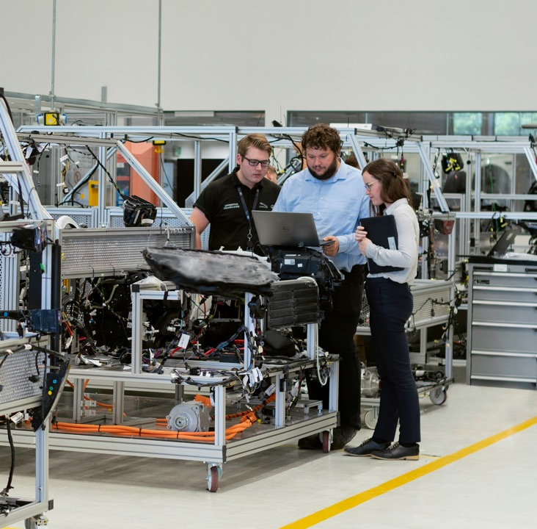
Transforming Operations with AI-Driven Insights
[Leading Global Manufacturer] faced growing pressure to improve operational efficiency and reduce downtime across its production facilities. They partnered with our Data & AI team to unlock the potential of their data and drive smarter, faster decisions.
THE CHALLENGE
The client struggled with siloed data, reactive maintenance, and rising costs due to unplanned equipment failures. Their existing systems lacked the predictive capabilities needed to stay ahead of disruptions.
OUR APPROACH
We implemented an advanced data platform integrating IoT sensor data, production logs, and ERP systems. A custom AI model was developed to predict equipment failures, optimize maintenance schedules, and uncover hidden inefficiencies.
THE IMPACT
20% reduction in unplanned downtime within 6 months
15% increase in production line efficiency
Real-time insights empowering proactive decision-making
Scalable AI framework ready to expand to global sites
Our collaboration not only delivered measurable improvements but also equipped the client with a future-proof foundation for continuous innovation and growth.
Notes:
Case example

